Slide 1
San Francisco Police Department Data Science Interview Project
Justin Irving
2/1/2024

Slide 2
Problem Statement
The San Francisco Fire Department (SFFD) must inspect properties designated as R-2 on an annual basis.
The Housing Inspection Services (HIS) division of the Department of Building Inspections (DBI) must conduct routine inspections of properties designated as R-2 at least once every five years and investigate complaints.
Question: How can SFFD and DBI prioritize their R-2 inspections to ensure that they are inspecting and identifying the highest risk buildings?

Slide 3
Approach
Exploratory Data Analysis (EDA)
Understand structure, clean data, perform joins
Perform basic feature engineering as deemed necessary
Check feature significance in explaining violations/incidents
Features considered after initial EDA included: property age, construction type, use definition
Cross-referenced violations from DBI and SFFD as an additional feature
Create classification models for violations and incidents
Provide recommendations based on data understanding and analysis
Note: If this were not a practice project, stakeholders would have been engaged at the beginning to define their concerns and drive analysis.

Slide 4
Analysis Questions and Assumptions
What defines a “high-risk” building?
Buildings that received a previous violation (SFFD or DBI) during a routine or complaint investigation
Buildings that previously received certain types of violations associated with hazardous conditions
Buildings prone to a fire incident or injury
What are the benefits of prioritization?
“High-risk” buildings can be investigated more often to reduce likelihood of safety incident
Focusing on “high-risk” buildings will help both departments make the most of their time and resources

Slide 5
Analysis Questions and Assumptions
What defines an R-2 parcel?
This analysis assumes R-2 parcels are any parcel inspected by the SFFD under the inspection_type_description “R2 Company Inspection” (N ≅ 5,300 distinct parcels)
Alternatively, defined R-2 parcels using Assessor Data land use and building code descriptions
Inconsistent with “R2 Company Inspection” (and ~15,000 more parcels)
In practice, parcel definition should be defined based on Assessor Data with the input from subject matter experts (SME) before analysis
What fire incidents should be considered as safety issues?
Removed incidents that did not correspond to a parcel (e.g., car fires at intersections)
Filtered fire incident data pertaining to a parcel to only include codes for building fire (most likely to be caused by code violations)
In practice, these assumptions would also be discussed and reconsidered with input from SME’s.

Slide 6
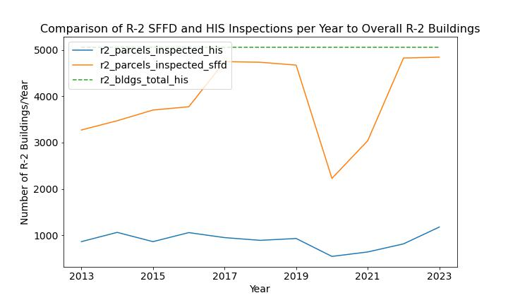
Current Routine Inspection Frequency
Question: Is SFFD or DBI having trouble inspecting all R-2 properties at the required frequency?
Answer: No, inspection frequency is meeting requirements.
Findings:
Based on our definition of R-2 parcels both agencies meet inspection frequency requirements.
SFFD inspects nearly all every year which is the goal (2020/2021 saw a decrease as expected due to pandemic)
HIS conducts routine inspections about once every five years which is the goal.
Next Steps: Confirm these findings with SMEs

Slide 7
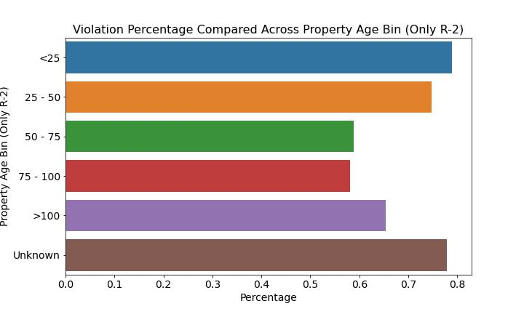
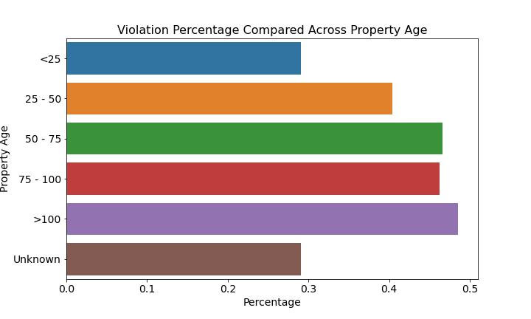
Factors that Relate to SFFD and HIS Violations
Definitions:
For SFFD, violation percentage is calculated as percentage of R-2 parcels with a violation across the factor.
For HIS, violation percentage is calculated as percentage of R-2 inspections with a violation across the factor.
Question: do certain factors relate to increased likelihood of a building inspection violation?
Answer: Yes, but causality needs to be considered further.
Findings:
Property Age
SFFD shows more violations for newer properties.
HIS shows more violations for older properties.
Construction Type
Both data sets show differences in violations across construction type, this could be useful in modeling.
Cross-referencing against SFFD/DBI violations for the same parcel did not appear to have predictive qualities.
Next Steps: Check additional features.

Slide 8
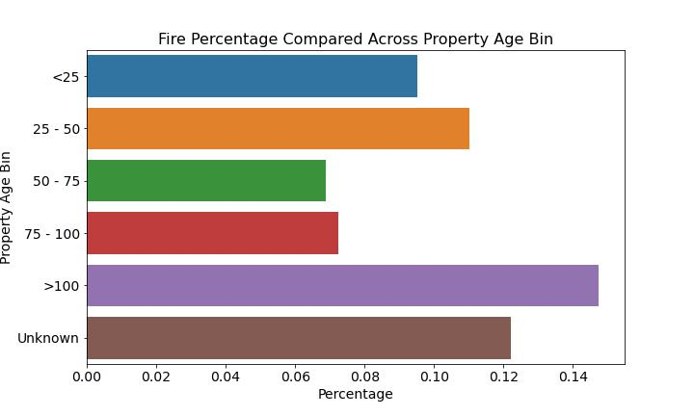
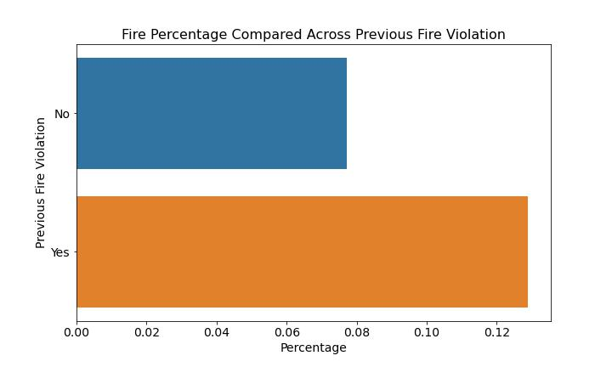
Factors that Relate to SFFD Incidents
Definition: SFFD incident percentage is defined as number of parcels in group with incident divided by all parcels in group in assessor active parcels. Figures in this slide are for R-2 parcels only.
Question: do certain factors relate to increased likelihood of a building fire incident?
Answer: Yes, but causality needs to be considered further.
Findings:
Older and newer properties seem to have higher incident rates than 50 – 100 year-old properties
Construction type shows differences in incident rates.
Previous Fire Violations and DBI Violations seem to be a relatively strong indicator of fire incidents at a parcel.
Next Steps: Confirm incidents of interest to SFFD and check addition features.

Slide 9
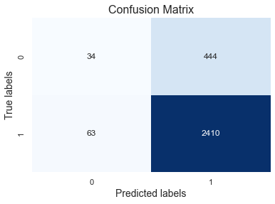
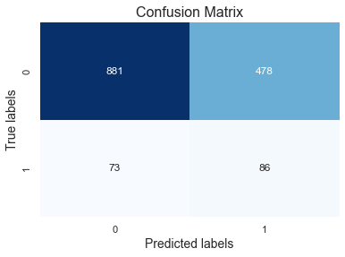
Modeling to Classify Violations and Incidents
HIS Violation Prediction Confusion Matrix
Question: can we create a classifier model that predicts whether a parcel will have a violation or incident at a better probability than what we see in the historical rates?
Impact: if successful, classifier model could help us prioritize high probability parcels first and these represent riskier buildings.
Answer: Yes, but…
SFFD Incident classification does a relatively good job classifying these low probability events. This could be used as a good tool to prioritize potential “high-risk” buildings after additional vetting.
HIS violation classification model good at identifying true positives but prone to false positives.
Causality needs to be considered further.
Detailed Findings:
Used random forest classifier with factors deemed interesting in initial analysis.
Classification models perform better than historical rates meaning output can be used to prioritize certain inspections.
Next steps: Test additional features, test alternative models.
Fire Incident Prediction Confusion Matrix

Slide 10
Summary of Next Steps
Meet with stakeholders to:
Confirm assumptions and general understanding of project goals.
Confirm/determine “base truth” logic for identifying R-2 parcels from assessor data.
Understand existing tools and methods for prioritizing fire inspections (e.g. Property Inspection Tool).
Additional analysis to:
Gain better understanding of assessor variables and consider how variables not used in this analysis could be leveraged in future analyses.
Consider adding available building permit data to analysis so recent construction can be targeted.
Test other classification models.
Code and Data Housekeeping:
Functionalize more code, additional commenting.
Set-up SQL transformations in dbt to enforce lineage.
Tie data pipeline together using orchestration tool (e.g. Airflow).
Consider what changes would be needed to put this into production to provide real-time feedback for SFFD and DBI.

Slide 11
Recommendations to Improve Data Sources
SFFD
Standardize primary situation in fire incident data.
DBI
Provide addition select boxes for complaint types on complaint form (appears to be mainly text which makes it hard to filter and run analytics on).
Use NLP to pull out keywords from text fields.
Perform additional NLP on violations text to enrich data on violation concern.
Standardize action_taken_primary field in fire incident data.
Integrate parcel spatial join into SFFD data pipelines so it does not need to be done after the fact (single source of truth).
Integrate real-time flag in SFFD R-2 database for pending/recent DBI violations
Integrate real-time flag in DBI R-2 database for pending/recent SFFD violations

Slide 12



Additional Information and Resources
All code is in a GitHub repository available at: https://github.com/justinirving314/sfpd_ds_question.git
Data Handling Process Summary
Data Sources
Data Ingestion
Data Transform and Store
Data Analysis

